Slide 1
Thunkable - Blue Screen

Slide 2
Goals
Insert a Slider – Design
Add Components
Blocks
Bonus

Slide 3
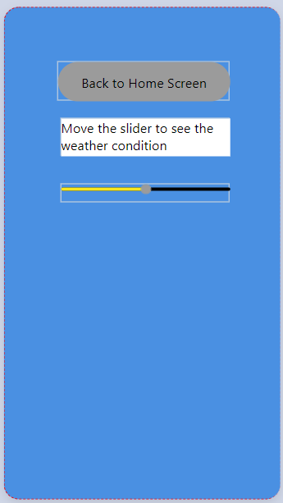
Goals
Add & View a Slider on the page
When the slider moves, hide/reveal/control different images shown on the page

Slide 4
Insert a slider - Design
Select the Blue screen
Go to the Design page
Add Component: Label
Name: ‘Temp_Instructions’, Hint: ‘Move the slider to see the weather condition’
Label background color: White (RGBA:255,255,255,1)
Add Component: Slider
Name: ‘WeatherSlider’,
Minimum Value = -5, MaximumValue = 5, value = 0, Step = 5
minimumTrackTintColor = Bright Yellow (RGBA:248,231,28,1)
maximumTrackTintColor = Black (RGBA:0,0,0,1)
thumbTintColor = Gray (RGBA:155,155,155,1)
5. Add images (3)
- Names: Snow, Cloudy_Sunny, Sunny

Slide 5
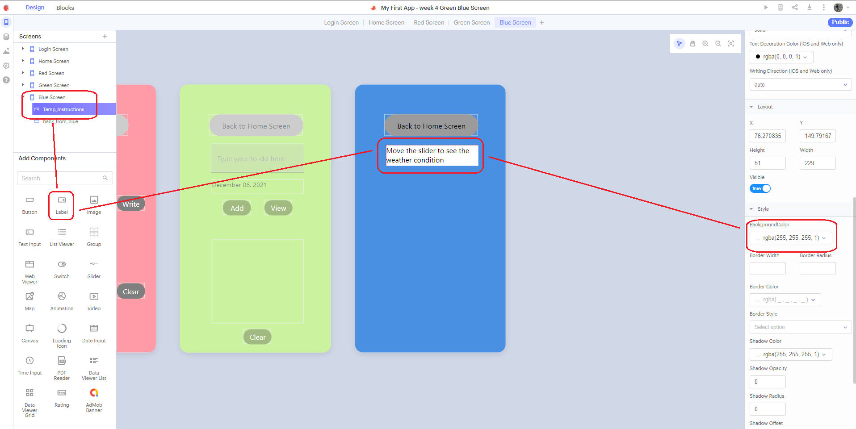
Add Component – Label

Slide 6
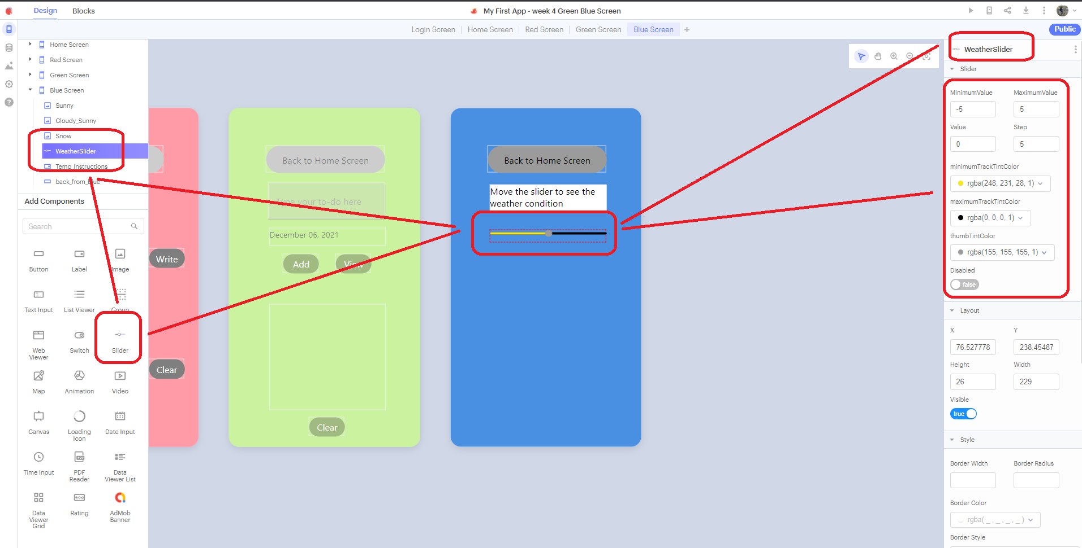
Add Component – Slider

Slide 7
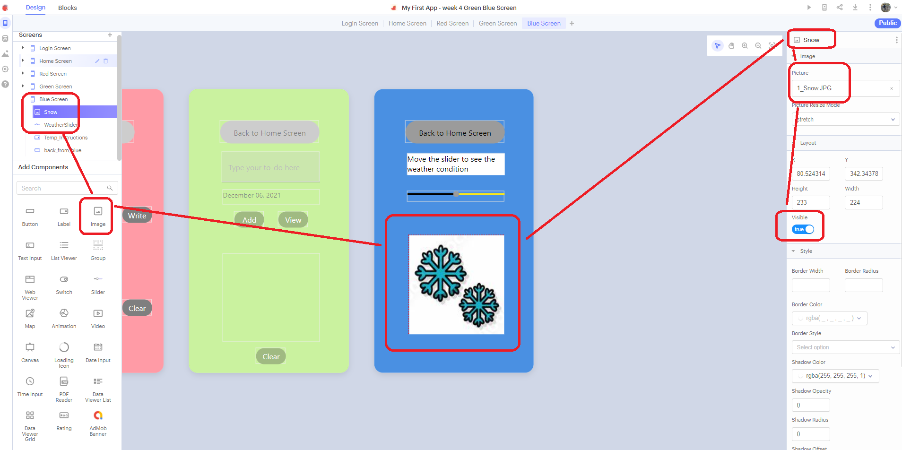
Add Component – Image

Slide 8
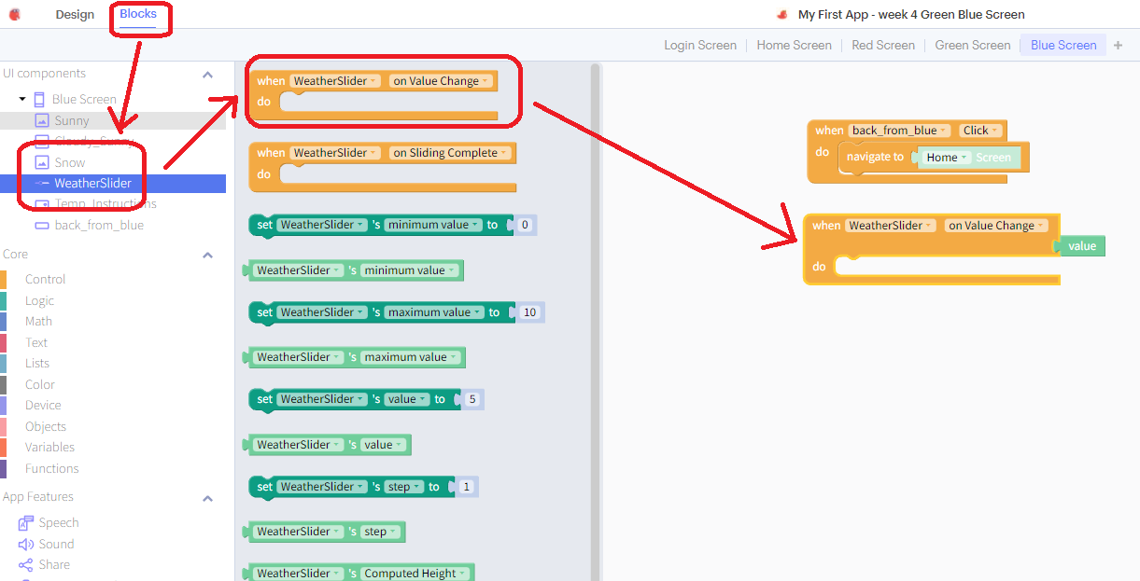
Blocks – WeatherSlider

Slide 9
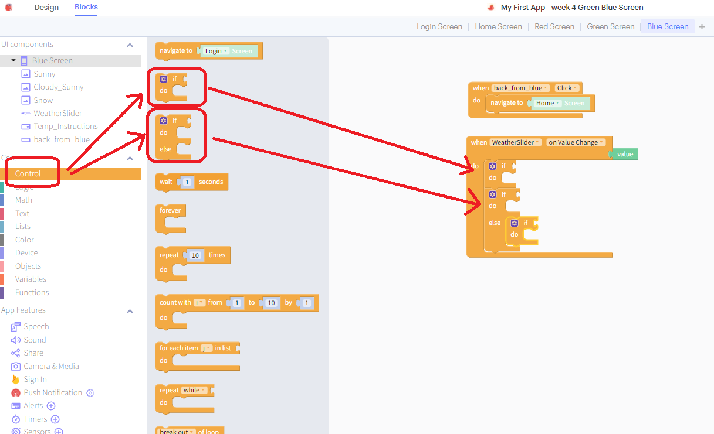
Blocks – Introduce If/ If-Else logic

Slide 10
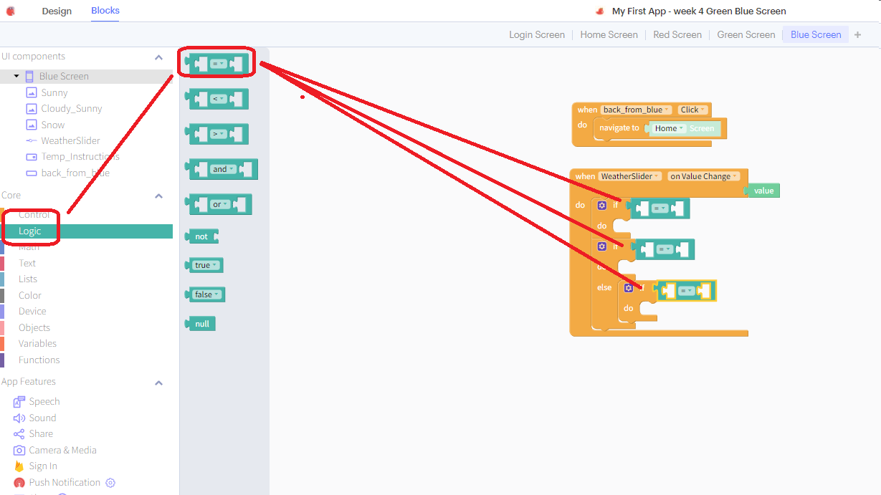
Blocks – Compare value of slider

Slide 11
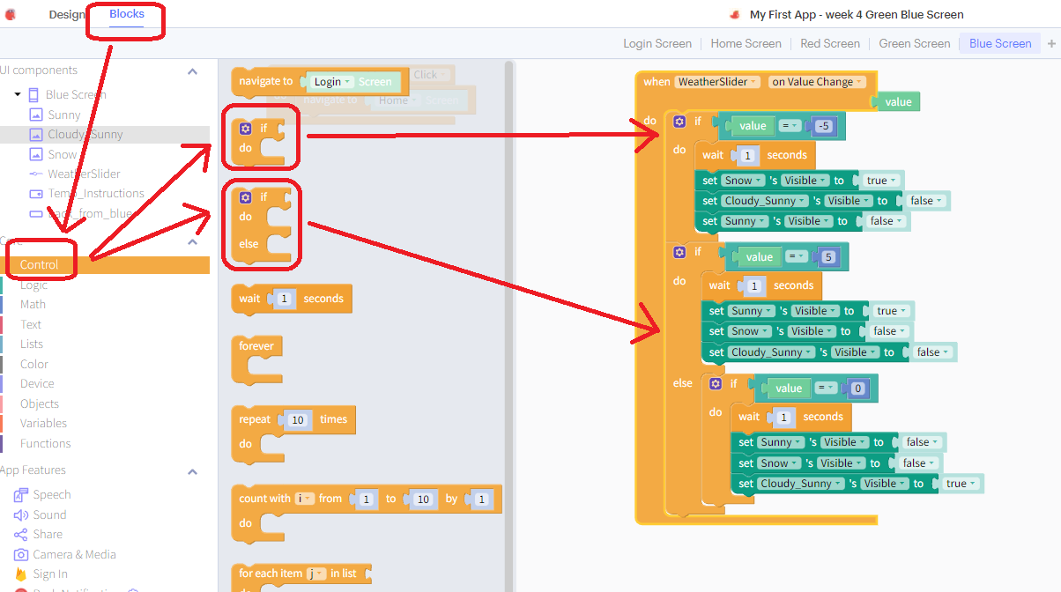
Blocks – Hide/Reveal images based on Slider

Slide 12
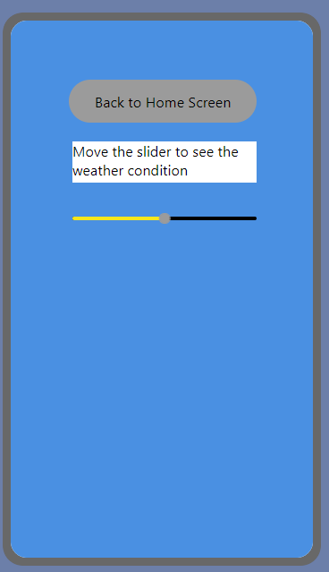
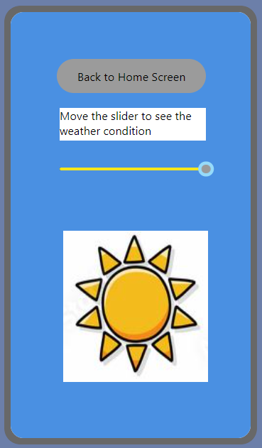
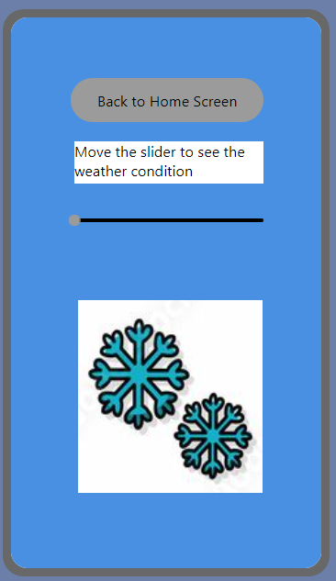
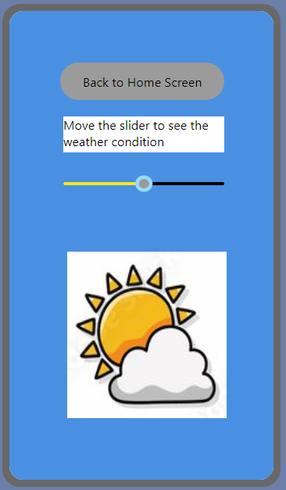
Blocks – Hide/Reveal images based on Slider
1. On-Load
2. Value = 5
3. Value = -5
4. Value = 0

Slide 13
Bonus
Add More Slider points to show Rainy Season
Add sounds to the page (rain or wind) when the slider moves based on the weather condition

